Slide 1
Defining Data Driven Needs for the Project Purpose 2017 Partnering Conference August 16, 2017
Walter Jeffery Moore, AICP
Senior Planner
Neel-Schaffer, Inc.

Slide 2
Your Assignment to draft a Purpose & Need Statement feels like:
Define the “universe”
& give two examples.

Slide 3
Agenda
The What of a P&N Statement?
The Why of a P&N Statement?
The P&N Building Blocks
Using Your Words: The Language of Purpose

Slide 4
WHAT is a P&N? A Tool for Communication
A clear & concise message directed to the public, officials, & consultants
The “battle cry” for the project; Consistent Message!
Included in the advertisement for Design or Planning Services
Included in meeting notices, invitation letters, media advisories, etc.
Notes:
The intent of a purpose and need statement is to provide a clear and uniform approach for KYTC and its partners to use in the development of a project. A preliminary purpose and need statement for the project is to be defined early in the initial design and environmental review stages of the project and developed more extensively during the public involvement process. The purpose and need statement shall be continuously evaluated during the development process and modified as needed based on information gained through the public involvement process.
The development of a project purpose and need statement is the responsibility of the project team. Purpose and need of a project are key decision points of the shared decision-making process. Purpose and need provide the foundation for successful decision-making and the basis for the evaluation and comparison of reasonable alternatives. Each project will have a purpose and need agreed upon by the project team, which will be utilized to establish the scope of the required work.

Slide 5
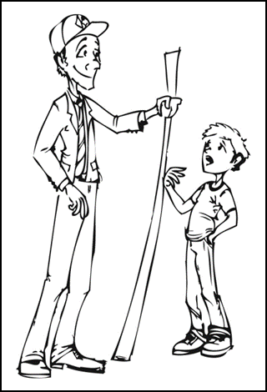
WHAT is a P&N? A Tool for Quality Decision Making
Guides the Development of Alternatives, Maintenance/Traffic Solutions, and the “No Build” Alternative
Screening Criteria for Alternatives
Decision to move the Project forward.
Clarifies and justifies the expected outcome of the investment
Notes:
The project team will also use the purpose and need to develop alternatives and to guide their decisions. For projects where the Division of Planning has completed studies, the project team should review, revise, and adopt the purpose and need presented in the planning report with consensus reached on all necessary modifications.
May mention bottom up or Performance Based Flexible Solutions. Beside “No Build” there may be valid maintenance type applications that meet the purpose and need.
Like the example P&N at the end. May mention here differences between P&N, SYP Project Description and Scope of work. Ties in later with the specific examples.

Slide 6
Legally required for projects that include NEPA documentation What is NEPA?
The National Environmental Policy Act (NEPA) is a United States environmental law that promotes the enhancement of the environment and established the President's Council on Environmental Quality (CEQ). The law was enacted on January 1, 1970. As the bill was an early step towards the development of the United States's environmental policy.
The Legal Guidance for Purpose & Need Statements comes from NEPA CEQ regulation, Section 1502.13.
“…shall briefly specify the underlying purpose and need to which the agency is responding in proposing alternatives including the proposed action.”
Notes:
A purpose and need statement is necessary for developing all projects. It is a requirement on projects that include future NEPA documentation, an environmental impact statement, or environmental assessment/FONSI. A clear, well-justified purpose and need discussion explains to the public and decision-makers that expenditure of funds is necessary and worthwhile and that the priority of the project is warranted when compared to other needed highway projects.

Slide 7
NOT CARVED IN STONE!
It is a fluid, living “narrative”.
The DRAFT P&N is continuously evaluated as information is gained from the public involvement process and data analysis.
The Project Team can refine the DRAFT P&N throughout the project development process.
When DRAFT P&N changes significantly then Project Team may need to revisit project assumptions.
Once Environmental Document is approved, changes to the P&N are difficult.
Notes:
May mention when P&N changes significantly then project team may need to revisit.

Slide 8
HOW? The Elements of a DRAFT P&N Statement
The Need
Supporting Data
Form and Function
EXISTING Conditions & FUTURE projections
The Purpose
Problem Statement in an “Active” format.
Goals & Objectives
Describes other issues to be resolved
Notes:
Would define supporting data compared to just existing data.

Slide 9
Purpose & Need Statements Less is always More.
Lord’s Prayer (66 words)
Most people know it.
10 Commandments (179 words)
Many can recite them.
Gettysburg Address (282 words)
Americans can talk about it.
US Regulations on the Sale of Cabbage (26,911 words)
Nobody cares.

Slide 10
The P&N Building Blocks
Facility Form & Function
Roadway Deficiencies
Existing or Future Capacity Demands
System Linkage
Safety Concerns
Modal Interrelationships
Transportation Plan Demand
Project Status & Legislative Commitment
Social or Economic Development Demands

Slide 11
Planners: The “Keepers of the Stuff”
Current/Future Traffic Volumes & Classification
Existing Roadway Information
Form (Highway Information System)
Function (Systems; Functional Classification)
Crashes: Type – Location – Frequency
Commercial-Industrial Development Needs
Intermodal Connections (Ped, Bike, Transit, Freight)
Cultural and Environmental Resources
Project Info: State Highway Plan, SHIFT Prioritization, and Specific Area/Corridor Planning Studies
SHIFT scoring information from Project Prioritizations
Notes:
We provide the information and context analysis for the system ‘as is’, and try and help find consensus on where we need to go. Some of the information that helps the advocates, the money providers, and the doers gain a sense of what is out there now is <READ SLIDE>

Slide 12
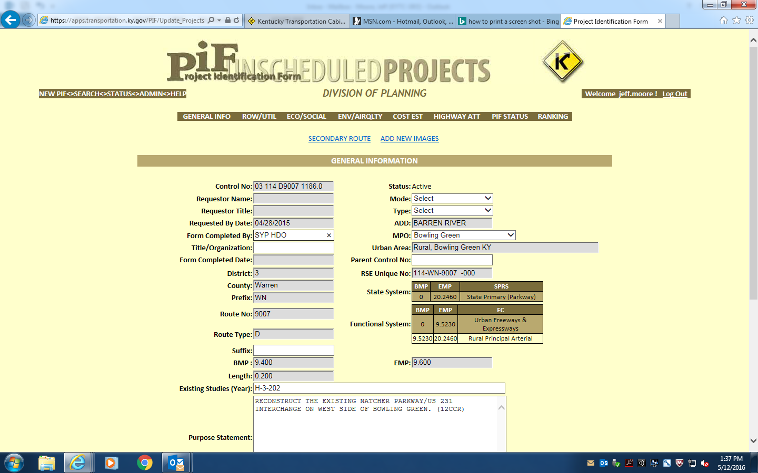
Project Identification Form (PIF) Describes the Project, its Origin, & Purpose
Existing Conditions
Form: Geometrics
Function: Traffic (Count & Classification)
Function: Crashes
Opportunities & Challenges
Utilities, Right of Way
Environmental Issues
Economic Issues
Notes:
May mention somewhere the evolution of P&N. From PIF to Study (DNA) to DES to Env Document.
Besides being possible, practical, and feasible the range of alts mush full P&N. See Key Decision Points in HD-203 for more information to talk about.

Slide 13
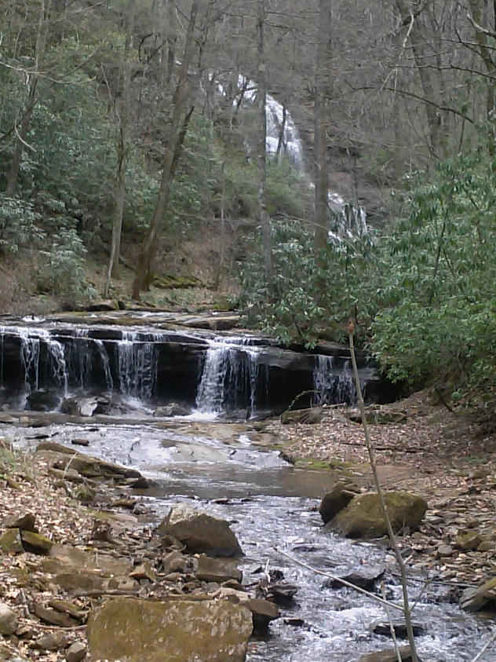
The Flow of the P&N
Project Identification Form (PIF)
Data Needs Analysis (DNA)
Design Executive Summary (DES)
Environmental Documents (CE, EA, EIS)
Notes:
The journey of P&N follows the flow of the project development. There may be turns, twists, pools, and boulders along the run as insights are gained from technical, public, and political input. (Photo: Pearsons Glen Falls, 2017)
The design executive summary (DES) is the record of engineering decisions related to the project. A signature from the director of the Division of Highway Design constitutes geometric approval and confirms the rationale used in determining geometric aspects of the proposed facility. The DES contains information about the project description, roadway characteristics, typical geometric criteria recommended for the roadway, existing conditions, and the project team's recommendations. The DES contains rationale concerning requested design exceptions and is utilized by the Division of Environmental Analysis in determining environmental actions that may be required. Since the DES documents the rationale used when making important design decisions, it is important to document reasons for conclusions that are made to provide a record of approvals. Should these decisions ever be challenged, the DES shows that a conscientious effort was made by the project team when reaching conclusions.

Slide 14
KY 100 (Simpson & Allen Counties) Project Need
As part of the Kentucky primary highway network, KY 100 is a rural two-lane facility which connects US 31E near Scottsville in Allen County to I-65 near Franklin in Simpson County. KY 100 is functionally classified as a “rural major collector”, linking the employment, education, governmental, and health service centers in Allen and Simpson Counties.
The narrowness of the lanes and shoulder along with the vertical alignment and horizontal alignment have been safety concerns of the community, especially in light of a significant number of roadway departure type of crashes and sideswipe collisions between large trucks.
With the improvements to the KY 100 corridor from Franklin to Scottsville currently underway, the next priority for improvement is slated as the section of KY 100 from the intersection with KY 622 in Simpson County to US 31E in Allen County.
Notes:
Encourage specific supporting data. Safety problems may be influenced by poor access management

Slide 15
KY 100 (Simpson & Allen Counties)
The PURPOSE of this project is to reduce the number of roadway departure and side-swipe crashes and to provide better a connection for travelers along KY 100 from the intersection with KY 622 to the intersection with US 31E as part of an overall improvement strategy for the entire KY 100 corridor.
Goals and objectives identified by the project team include improving safety, providing better access to employment opportunities and for freight movement.
In the short-term, these goals and objectives may be accomplished by spot improvements targeting improved safety and better access for trucks. Ultimately, the project team envisions an improved cross section for the entire corridor and would like to establish a consistent cross section to be used for short-term spot improvements.

Slide 16
Using Your Words: The Language of Purpose
Safety
Congestion
Facility Deficiencies
Legislative Intent/Community Commitment
Economic Development
RED statements are “bad” examples while the BLACK statements are “good” examples.

Slide 17
The Language of Purpose
Safety
The purpose of this project is to improve safety on US 31W.
The purpose of this project is to reduce the number of roadway departure crashes along Plano Road.
The purpose of this project is to reduce pedestrian and motorist conflicts along Dixie Highway.

Slide 18
The Language of Purpose
Congestion
This project is to increase the capacity along US 231 south of Morgantown. (YIKES!)
The purpose of this project is to reduce vehicular travel times along Scottsville Road during afternoon peak travel periods.
This purpose of this project is provide a consistent flow of traffic at an operating speed of 55 miles per hour along this section of the US 60 Bypass.

Slide 19
The Language of Purpose
Facility Deficiencies
The purpose of this project is to replace the existing US 68 bridge over the Green River.
The purpose of this project is to eliminate the deficient status of the bridge on US 60 over the Cumberland River at Smithland.
The purpose of this project is to provide adequate opportunities for passing sight distance along KY 90 between Glasgow and Summershade.
Notes:
Classic example. May remove bridge or bypass stream crossing vs. needing to correct deficiencies.

Slide 20
The Language of Purpose
Connection or Access
The purpose of this project is to link Brownsville to Bowling Green.
The purpose of this project is to improve cross-river mobility and connectivity between Milton and Madison
The proposed improvements on Cemetery Road will provide a direct east-west connection across I-64 and provide better access to major roadways.

Slide 21
The Language of Purpose
Economic Development
The purpose of this project is improve Economic Development opportunities for Tompkinsville.
The purpose of this project is to help manage traffic congestion and development access for both existing and future commercial and residential development at the interchange of KY 100 and I-65.
The purpose of this project is to provide access for large commercial vehicles along KY 259 into Brownsville.

Slide 22
KYTC P&N Guidance
Design Memo from 2005 (http://transportation.ky.gov/Highway-Design/Documents/Purpose%20and%20Need%20Statement%20Guidance%20and%20Instructions.pdf)
Instructions in the Highway Design Policy Guide (http://transportation.ky.gov/Highway-Design/Highway%20Design%20Manual%202015/HD-200.pdf, chapter 202.6.1) also in HD103 (Key Decision Points).

Slide 23
Any Questions?
Walter Jeffery Moore, AICP
Senior Planner
Neel-Schaffer, Inc.
Jeff.moore@neel-schaffer.com

